Slide 3
Want to learn more about PCF?
YOU’RE INVITED TO
NEW CONNECTIONS LUNCH
(4th Sunday of each month)
Light lunch with new friends
Get to know pastors and a few leaders
Learn the history of PCF, core values and practical information

Slide 4
Saturday Online Prayer Meeting
Every Saturday morning at 9:30 am

Slide 8
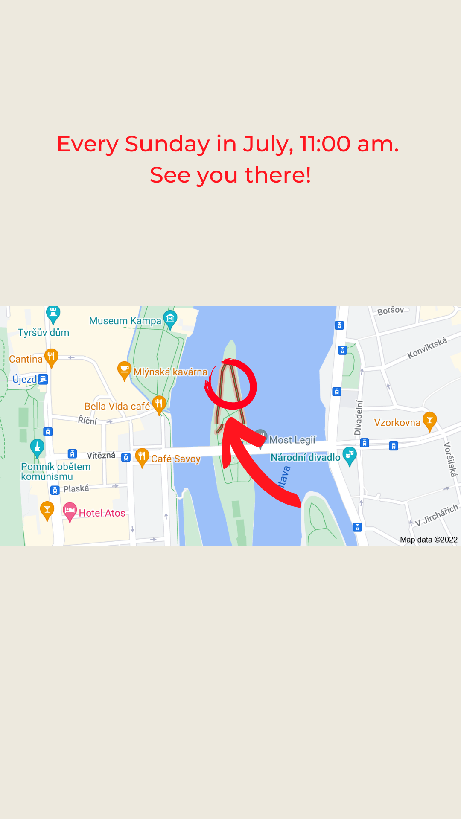

Slide 12
Visit the INFO TABLE in the foyer and check out which HOME GROUP is best for you!

