Slide 1


Slide 2


Slide 3

Want to learn more about PCF?
YOU’RE INVITED TO
NEW CONNECTIONS LUNCH
(4th Sunday of each month)
Light lunch with new friends
Get to know pastors and a few leaders
Learn the history of PCF, core values and practical information

Slide 4

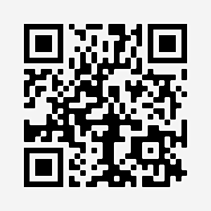
Saturday Online Prayer Meeting
Every Saturday morning at 9:30 am

Slide 5


Slide 6


Slide 11


Slide 12


Slide 13


Slide 14


Slide 15


Slide 16


Visit the INFO TABLE in the foyer and check out which HOME GROUP is best for you!

Slide 17


Slide 18


Slide 19


