Slide 1


Slide 2


Slide 3

Want to learn more about PCF?
YOU’RE INVITED TO
NEW CONNECTIONS LUNCH
(4th Sunday of each month)
Light lunch with new friends
Get to know pastors and a few leaders
Learn the history of PCF, core values and practical information

Slide 4


Slide 5


Slide 6


Slide 7


Slide 8


Slide 9
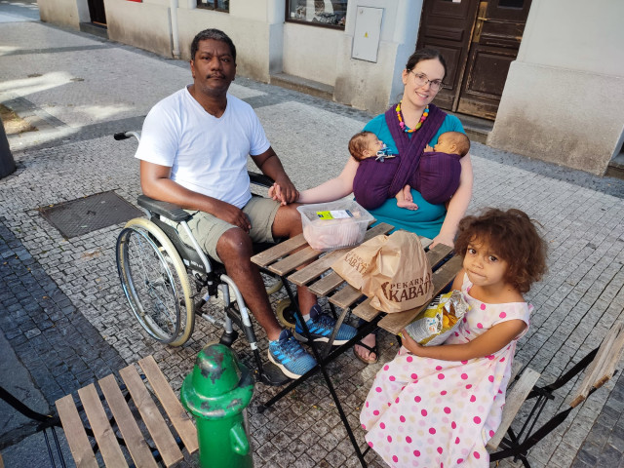
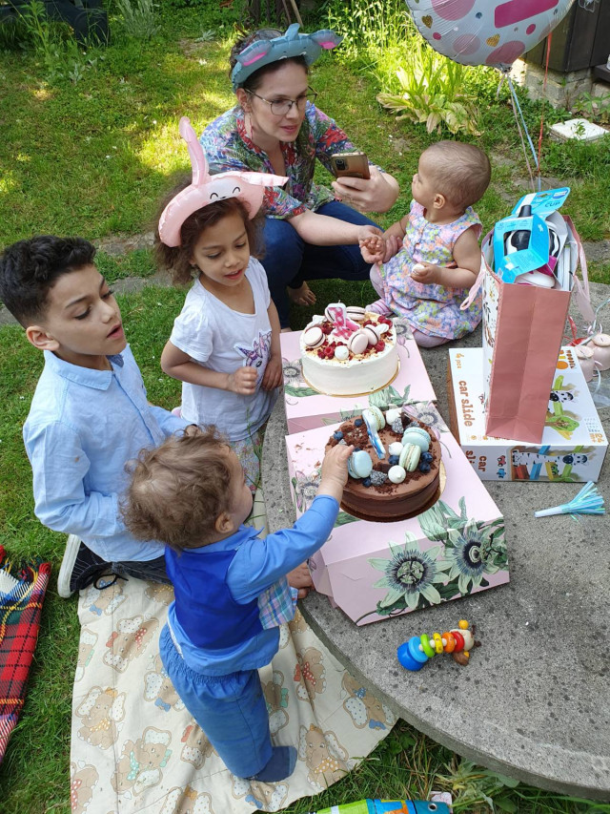
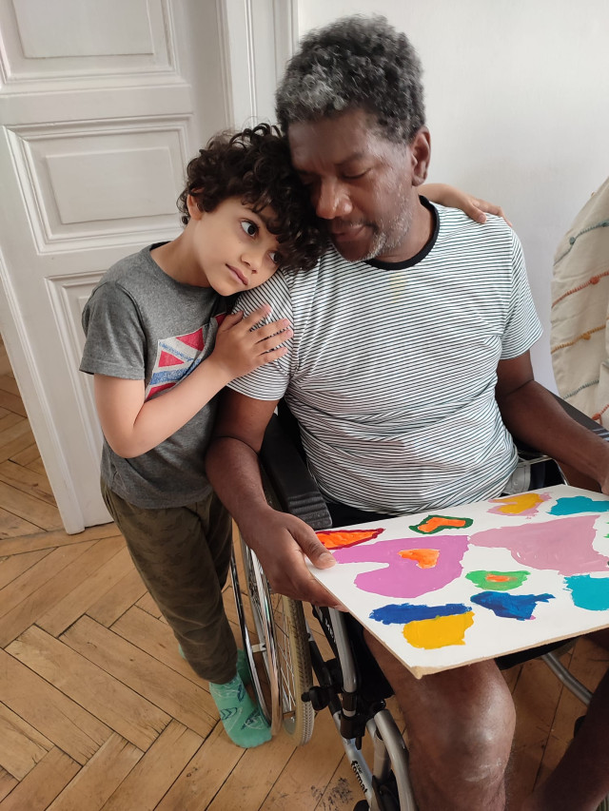
Together we can Help
Open Donation For REVIERO FAMILY
Please consider donating to help our dear friends Carlos and Zuzana Reviero to purchase a 8 seat vehicle which will fit the whole family and electric wheelchair for Carlos. Shall more than the necessary amount be collected, it will be used to pay for therapies either at home or at a specialized therapy centre.
https://www.donio.cz/zivot-nepocka-auto-ktere-uveze-celou-rodinu

Slide 10
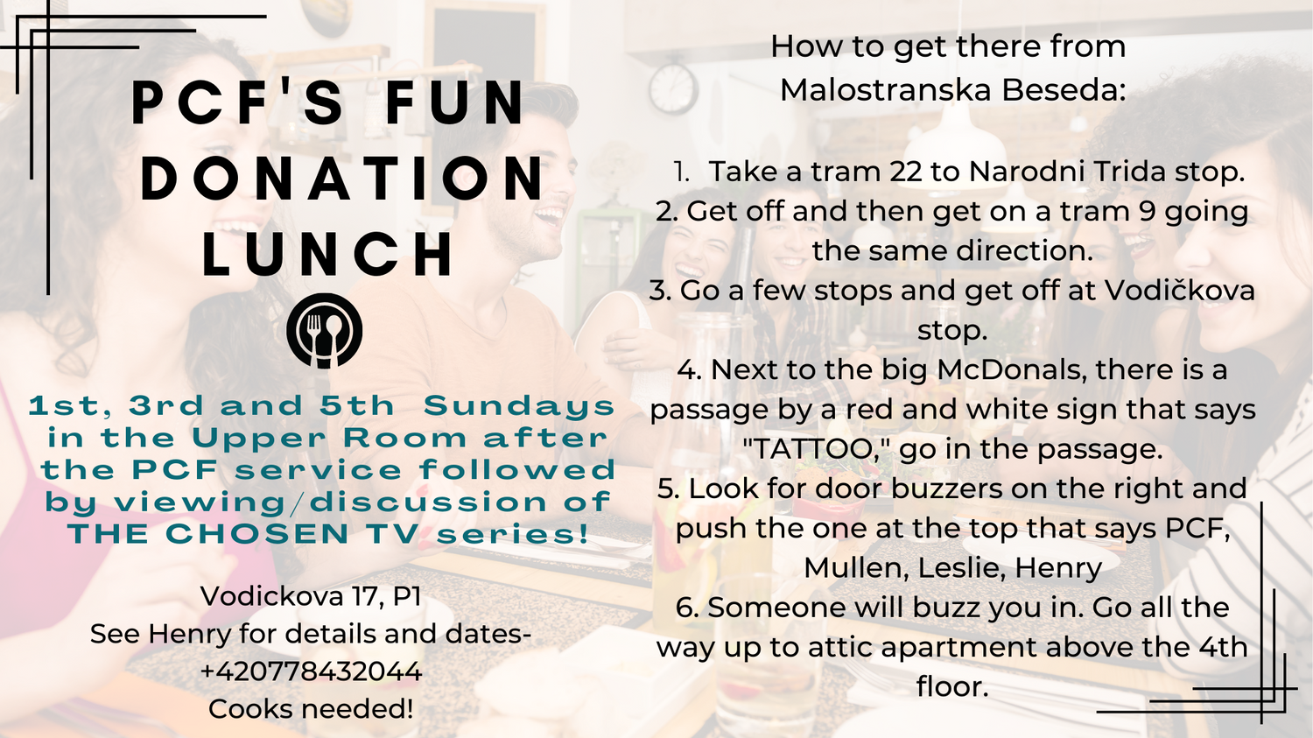

Slide 11


Slide 12


Slide 13
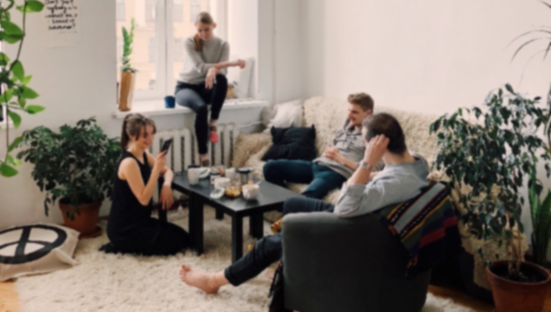

Visit the INFO TABLE in the foyer and check out which HOME GROUP is best for you!

Slide 14


Slide 15


Slide 16


